Slide 1
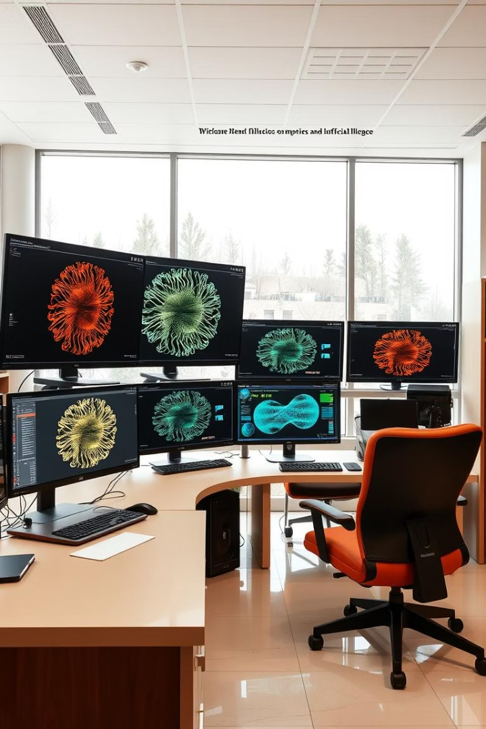
Accelerating ResNet‑18 Training on CIFAR‑10: A Comprehensive Profiling & Optimization Study

Slide 2

Project Overview
This project aims to enhance the training efficiency of ResNet-18 on CIFAR-10 through systematic profiling and optimization. By analyzing different compute environments, we seek to improve performance and reduce costs.

Slide 3
Why We're Doing This
Identify Bottlenecks in training such as data loading and memory usage.
Compare Performance across CPU, multi-threaded CPU, GPU (FP32), and GPU with AMP (FP16+FP32).
Leverage Profiling Tools to gain clear visibility into resource utilization.
Evaluate Trade-offs between speed and memory efficiency during training.
Understand Optimization Impact on overall training throughput and efficiency.

Slide 4
Evaluation Experiments
CPU Single Thread (Baseline): Measures the sequential training cost without optimizations.
CPU Multi-threaded: Assesses improvements from parallel data loading and concurrency.
GPU FP32: Tests full precision GPU acceleration for speed and memory use.
GPU with AMP: Uses mixed precision to cut training time and reduce memory demand.
AMP Batch Size Sweep: Analyzes throughput and memory from batch sizes 16 to 512 to find optimal setup.

Slide 5
Experiment 1 – CPU Single Thread (Baseline)
Device: CPU using a single thread
DataLoader: num_workers set to 0, sequential loading
Batch Size: 128 for balanced memory use
Training Mode: Fully sequential without parallelism
Profiler: PyTorch torch.profiler to measure baseline metrics
Notes:
In Experiment 1, our goal was to establish a baseline for training ResNet‑18 on CIFAR‑10 without any performance optimizations. We used: A single-threaded CPU setup, No parallel data loading (num_workers = 0), And default PyTorch training with batch size 128. This means that both data loading and model training happened in a strictly sequential fashion. This setup simulates what training looks like without multithreading, GPU acceleration, or memory prefetching—purely CPU-driven and minimalistic.

Slide 6
Experiment 1 – Results and Observations
Epoch Time: Approximately 19 seconds per training epoch
Throughput: Around 180 to 200 images processed per second
Bottlenecks Identified: Heavy computation in convolution_backward function
Memory Operations: aten::clone and aten::copy_ slow down performance
Notes:
We trained ResNet‑18 for one epoch on CIFAR‑10 using a single CPU thread and no parallel data loading. The training took about 19 seconds per epoch, and the throughput was around 180 to 200 images per second. When we profiled the training loop, we noticed two major types of bottlenecks: Computation: The convolution_backward function was consuming a large portion of CPU time. This is expected—convolution is compute-intensive and runs serially here. Memory Overhead: Functions like aten::clone and aten::copy_ were also significant, indicating a high cost of tensor copying and memory layout changes. Since we used no multithreading or prefetching, the data loading happened in the main thread and blocked the compute step. This caused visible idle time between batches, leading to underutilization of the CPU.

Slide 7
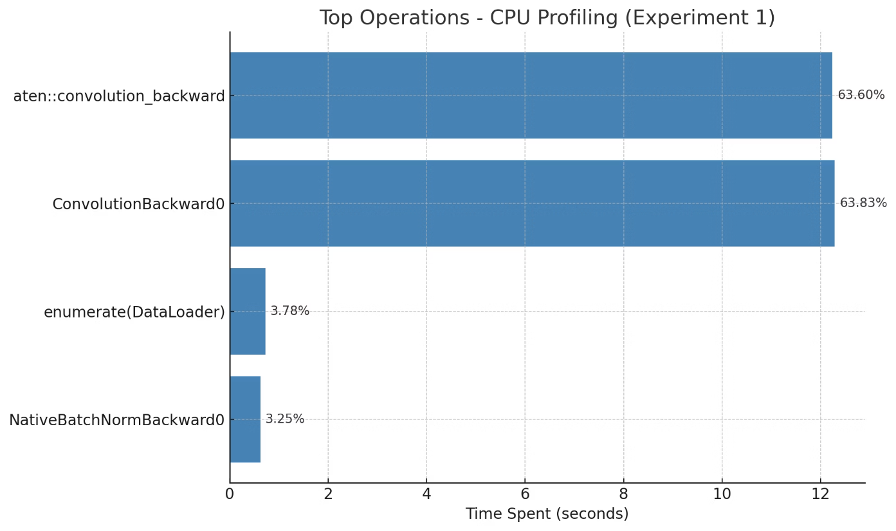

Slide 8
Experiment 2 – CPU Multi-Threaded
Device: CPU utilizing 6 threads for compute tasks
DataLoader: Parallel data loading enabled with num_workers set to 4
Batch Size: 128 to maintain consistency with baseline
Training Mode: Sequential compute combined with threaded I/O operations
Profiler: PyTorch torch.profiler used for detailed function timing and CPU load analysis
Notes:
In Experiment 2, our goal was to improve on the sequential CPU baseline by adding thread-level parallelism. We kept training on the CPU but made two key changes: We allowed 6 compute threads using torch.set_num_threads(6), enabling PyTorch to parallelize tensor operations like matrix multiplies and convolutions. We enabled parallel data loading by setting num_workers=4 in the DataLoader. This allows multiple subprocesses to prepare batches concurrently while the model is training. The batch size remained the same—128—to isolate performance changes solely due to threading, not memory or batch-size effects.

Slide 9
Experiment 2 – Insights & Results
Epoch Time
Throughput
CPU Bottlenecks
Training completed in approximately 7.6 seconds per epoch.
Achieved 350 to 400 images processed per second on CPU multi-threading.
aten::convolution_backward consumes 85.3% of total CPU time.
Backend Optimization
Key Observation
mkldnn_convolution contributes 7.5%, indicating optimized backend utilization.
Significant speedup achieved through parallel data loading and multi-threading.

Slide 10
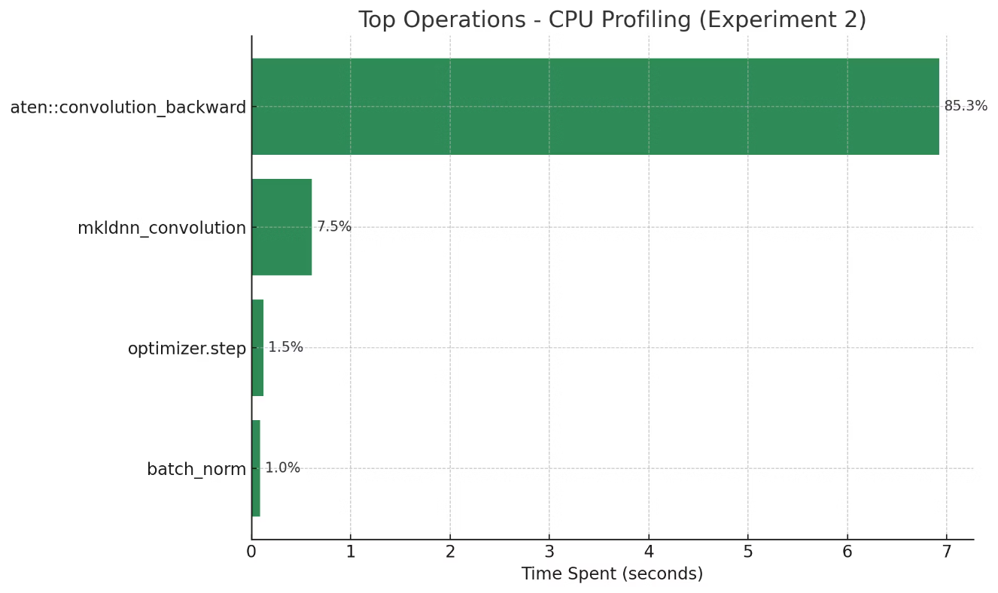

Slide 11
Experiment 3 – GPU Full Precision (FP32)
Device: NVIDIA GPU with CUDA support for accelerated computing
Precision: FP32 (32-bit floating point) for accurate model calculations
DataLoader: 4 workers actively loading data with pinned memory enabled
Batch Size: 128 for balanced throughput and memory use
Training Mode: Model and data fully on GPU to minimize bottlenecks
Profiler: torch.profiler tracks CPU and CUDA operations for deep insights
Notes:
In Experiment 3, we transitioned from CPU-based training to GPU acceleration using full precision (FP32). Our goal here was to offload the computational workload to the GPU in order to: Maximize parallel processing with CUDA cores, Drastically reduce epoch time, And analyze how GPU training differs from CPU in terms of both bottlenecks and memory behavior. The setup was as follows: The ResNet‑18 model and CIFAR‑10 data were moved to the GPU, We kept the batch size at 128 for consistent comparison, Enabled 4 DataLoader workers and pinned memory for faster host-to-device transfers, And used PyTorch's torch.profiler to monitor both CPU and CUDA activity, especially during the first epoch. This configuration allowed us to analyze how computation was distributed across GPU kernels and whether data transfer overhead became a limiting factor. Experiment 3 serves as a key turning point in our optimization path—by shifting computation from CPU to GPU, we expected a major gain in throughput, and we were particularly interested in how CUDA kernel activity dominated compared to CPU-side operations. In the next slide, we’ll look at those results.

Slide 12
Experiment 3 – Results & Insights
1
Epoch Time
2
Throughput
Reduced to ~2 seconds with a batch average of ~0.58 ms
Achieved over 5000 images processed per second
3
Key CUDA Kernels
4
Insight
Convolution backward: 48.3%, cudnn convolution: 20.6%, optimizer step: 21.1%
GPU offload provides major speedup; memory and kernel launch efficiency are critical
Notes:
Now let’s examine what we found in Experiment 3. This time we shifted the entire training process to run on the GPU using full FP32 precision. As expected, this gave us a huge boost in performance. Epoch time dropped drastically to around 2 seconds, and throughput exceeded 5000 images per second. When we profiled the GPU, here’s what stood out: The aten::convolution_backward CUDA kernel consumed nearly half of the GPU execution time—which aligns with its known cost in backward propagation. Forward convolution was handled by cudnn_convolution, taking up about 21% of total CUDA time. Interestingly, Optimizer.step on GPU was also quite expensive—accounting for another 21%. This includes weight updates, which are now handled via fused CUDA operations. Another important detail: there was still a notable cost (~7%) from runtime module loading and tensor layout conversions (nchw <-> nhwc), showing that kernel launch and memory layout still impact performance—even on GPU. Overall, Experiment 3 confirms that offloading training to GPU offers massive gains, but it also shifts our bottlenecks from data loading to CUDA kernel time and memory throughput. We’re now in the domain where finer optimizations—like operator fusion or mixed precision—can make a measurable difference. That’s exactly what we explore in Experiment 5. Let me know if you’d like a visual breakdown of this profiler summary too!

Slide 13
What We Offloaded to the GPU
Forward pass: Convolution, BatchNorm, ReLU, Pooling processed on GPU
Backward pass: Gradient computations for all neural network layers
Optimizer: optimizer.step() executed fully on GPU for speed
Tensor operations: matmul, addmm, and element-wise operations accelerated
CPU responsibilities: Data loading, memory staging, and kernel launch coordination
Notes:
This slide breaks down exactly what operations moved to the GPU in Experiment 3. The most compute-intensive parts of training were fully offloaded: The forward pass, including convolutional layers, activation functions like ReLU, pooling, and normalization layers, all executed as fast CUDA kernels. The backward pass, which computes gradients for weights and activations, also ran entirely on the GPU. As shown in the profiler, aten::convolution_backward alone consumed nearly half of CUDA time. We also saw that optimizer.step() was now a major CUDA workload—because weight updates (including momentum and decay) were fused into GPU operations. Other general-purpose operations like matrix multiplications (matmul, addmm) and element-wise computations also occurred on the GPU. However, it’s important to note that the CPU still played a key role in: Data loading through DataLoader workers, Memory staging via host-to-device transfers (especially if pinned memory wasn’t used efficiently), And the launching of CUDA kernels—which means synchronization and scheduling overheads can still occur. In summary, the entire compute graph was GPU-bound, but we still relied on the CPU for data movement and control logic, which we aim to streamline in later experiments.

Slide 14
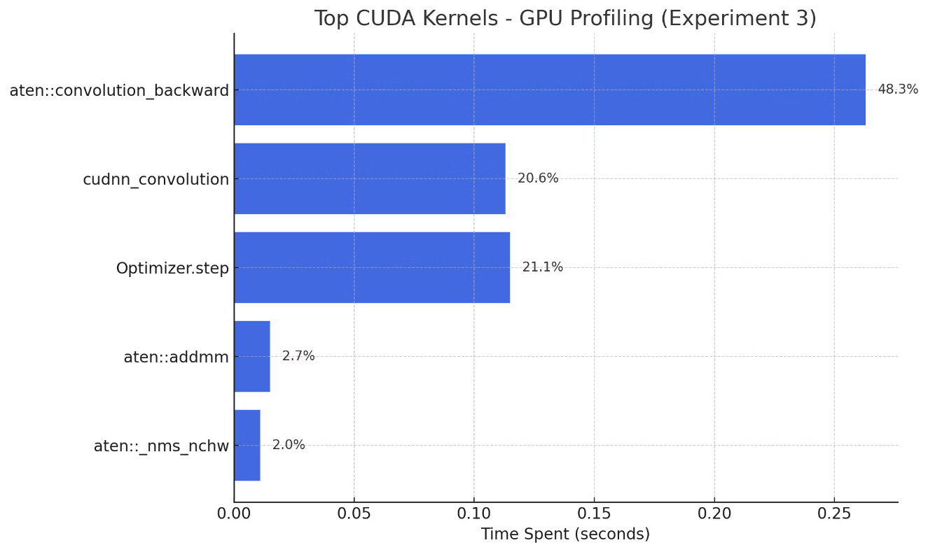

Slide 15
Experiment 4 – GPU with AMP (Mixed Precision)
Device: GPU with Tensor Core support for enhanced performance
Precision: Mixed FP16 and FP32 managed via autocast()
Scaler: torch.cuda.amp.GradScaler() for stable gradient scaling
Batch Size: 128 for balanced throughput and memory use
Training Mode: Full GPU usage with mixed precision computations
Profiler: CPU and CUDA kernels profiled by torch.profiler tool
Notes:
Experiment 5 focuses on taking GPU optimization one step further using Automatic Mixed Precision, or AMP. AMP allows us to run operations in FP16 precision where it’s safe and beneficial, while automatically falling back to FP32 for critical operations like softmax or loss calculations. This combination enables us to: Speed up training using Tensor Cores (specialized hardware on modern NVIDIA GPUs), And significantly reduce GPU memory usage, allowing for larger batch sizes or parallel workloads. The setup here remains similar to Experiment 3: We train ResNet-18 on CIFAR-10 with a batch size of 128, Use 4 workers for data loading with pinned memory, And the model and optimizer are fully moved to the GPU. The difference is that all training steps are now wrapped in autocast(), and the backward pass is scaled using GradScaler to prevent underflow of gradients in FP16. This experiment helps us evaluate how much faster and memory-efficient training becomes with AMP—and how it affects throughput and resource utilization compared to full FP32 precision from Experiment 3. In the next slide, we’ll look at the profiler summary and key insights. Let me know if you want this visualized or narrated for a slide deck.

Slide 16
FP32 vs. FP16 Comparison
Aspect
FP32 (Full Precision)
FP16 (Half Precision / AMP)
Precision
High (~7 decimal digits)
Lower (~3.3 decimal digits)
Speed
Slower on GPU
~2x faster with Tensor Cores
Memory Use
High (more GPU memory required)
Low (50% less per tensor)
Stability
Very stable across layers
May underflow/overflow (handled by AMP)
Use Cases
Loss, softmax, critical ops
Conv, matmul, most model layers

Slide 17
Experiment 4 – Results & Insights
1.8s
6800
Epoch Time
Throughput
Average time per training epoch
Images processed per second
41.6%
21.6%
Conv Backward
Optimizer Step
Percentage time spent in convolution backward kernel
Time spent updating model parameters
AMP accelerates key CUDA kernels and greatly reduces memory use.
Notes:
In Experiment 5, we used AMP (Automatic Mixed Precision) to accelerate training by performing most operations in FP16 and falling back to FP32 when necessary. Let’s look at the profiler summary: Throughput jumped to approximately 6,800 images per second, which is ~30% faster than FP32 training from Experiment 3. The CUDA kernel aten::convolution_backward still dominates GPU time but now takes 41.6%, down from 48% in FP32. The Optimizer.step process accounted for 21.6% of CUDA time, showing that parameter updates remain significant even under mixed precision. cudnn_convolution used for forward pass consumed about 20%, similar to FP32. We also noticed non-compute operations like layout conversions (nchw → nhwc) and runtime-triggered module loading each consuming around 8–15%, which suggests memory layout optimization could further improve performance. Crucially, AMP resulted in reduced memory usage, meaning we could potentially increase batch size or run multiple models in parallel. Overall, Experiment 5 demonstrates that AMP provides both speed and efficiency, especially on modern GPUs with Tensor Core support. It's the best-performing configuration so far in our experiments.

Slide 18
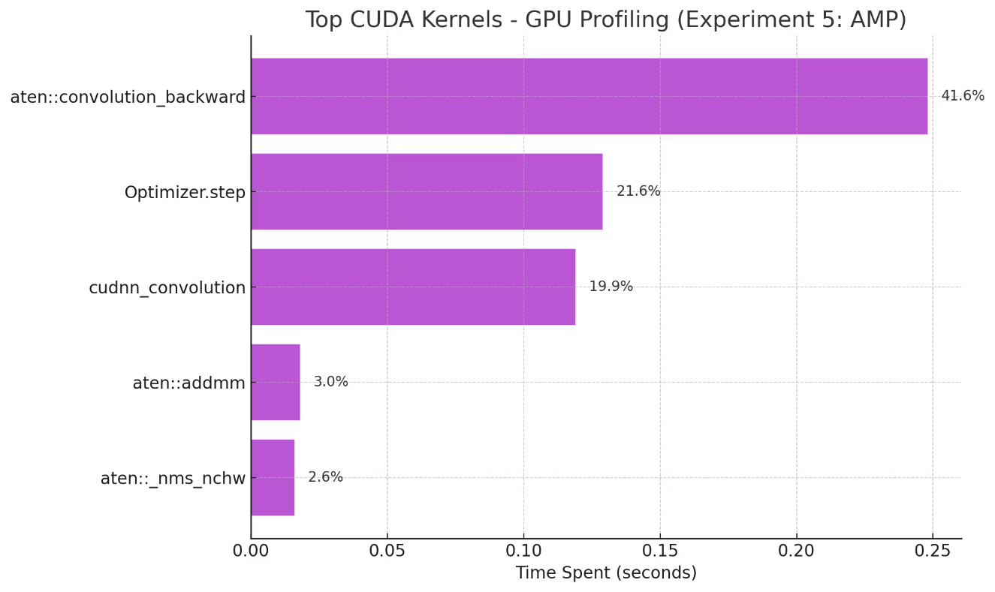

Slide 19
Comparative Metrics Across Experiments
Metric
Exp 1 CPU 1T
Exp 2 CPU 6T
Exp 3 GPU FP32
Exp 4 GPU AMP
Device
CPU (Single Thread)
CPU (6 Threads)
GPU (FP32)
GPU (AMP: FP16 + FP32)
Epoch Time
~19 sec
~7.6 sec
~2.0 sec
~1.8 sec
Throughput
~180 img/s
~350–400 img/s
~5,200 img/s
~6,800 img/s
Batch Size
128
128
128
128
DataLoader
0 workers
4 workers
4 workers, pinned
4 workers, pinned
Precision
FP32
FP32
FP32
Mixed (AMP)
Main Bottleneck
Data + conv (serial)
convolution_backward
CUDA conv & opt step
CUDA conv + layout ops
GPU Memory (Peak)
–
–
~950 MB
~925 MB
Profiler Insights
High CPU idle & clone ops
MKLDNN used, better CPU use
Tensor-heavy CUDA kernels
Faster conv + memory gains
Notes:
This table summarizes all four experiments side by side. Experiment 1 is our baseline—single-threaded CPU with no parallelism. It’s the slowest and most memory-limited. Experiment 2 shows how adding threads and parallel data loading cuts epoch time by more than half. Experiment 3 offloads everything to the GPU, giving us a massive 10x speedup in throughput. Experiment 5 improves further with AMP, using mixed precision to reduce memory and boost speed by another ~30%. Each step reflects a strategic optimization—first improving the CPU pipeline, then scaling compute with GPU, and finally squeezing performance with AMP.

Slide 20
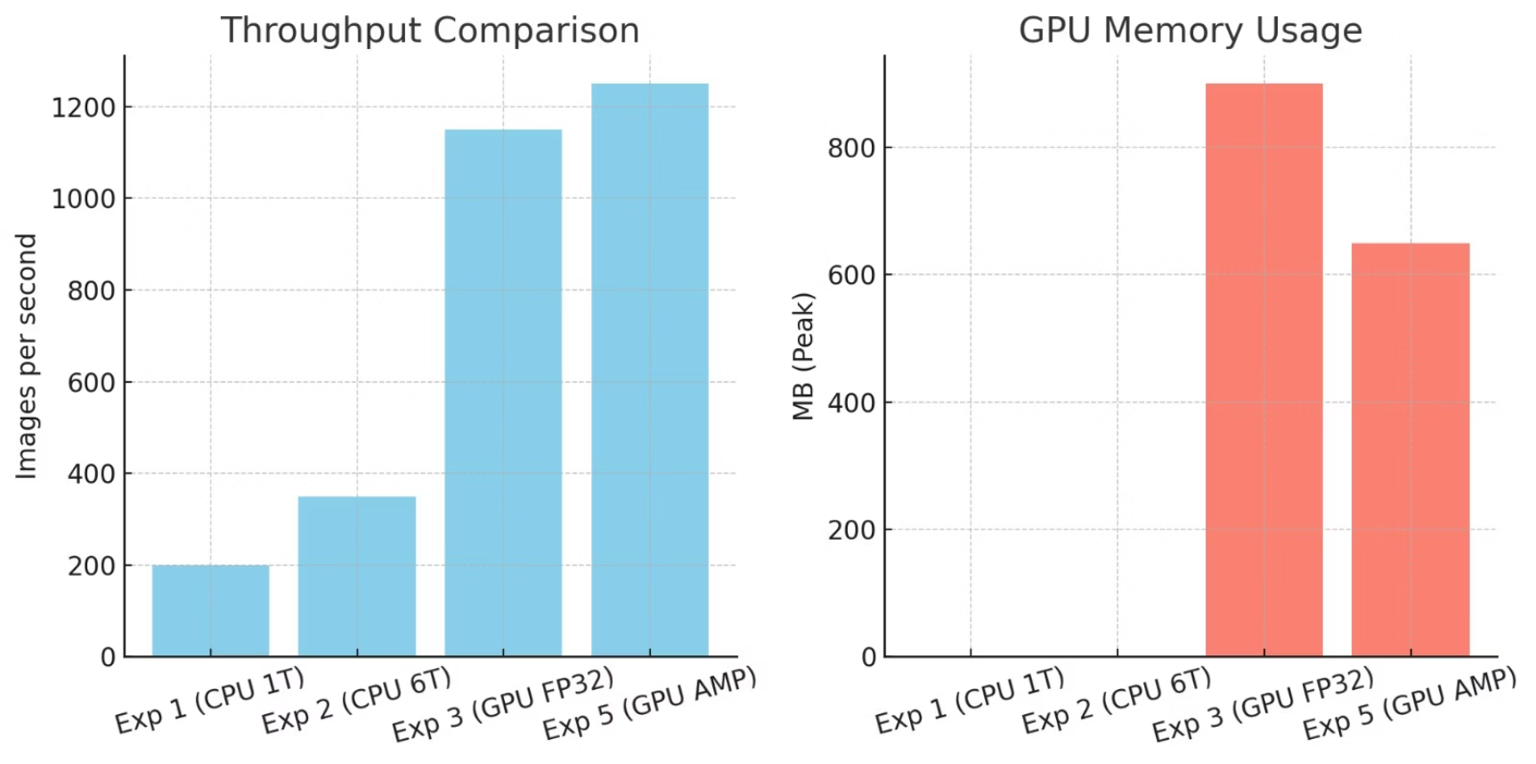

Slide 21
Experiment 5 – Results & Insights
Best Throughput
Memory Usage Trend
Batch 512 achieved 1070 images per second, batch 256 reached 1062 img/s.
Memory increased from 191 MB at batch size 16 to 1580 MB at batch 512.
Efficiency Sweet Spot
Key Observation
Batches between 128 and 256 balance high throughput with stable memory use.
Increasing batch size boosts GPU efficiency until memory limits are reached.
Notes:
In Experiment 4, we tested how different batch sizes affect performance under AMP on GPU. We trained for one epoch at each batch size from 16 up to 512, recording: Training time Images processed per second And peak GPU memory usage Here’s what we found: Throughput improved steadily as batch size increased. At batch size 16, we had just ~318 img/s. But by batch size 128, it climbed to ~941 img/s. The highest throughput was achieved at batch size 512: 1070 images/sec, with 1580 MB GPU memory used. Batch 256 was nearly identical in throughput but used 600 MB less memory, making it the most efficient sweet spot. Below batch size 64, GPU utilization was clearly suboptimal, with longer training times and lower throughput. In summary, Experiment 4 shows that tuning batch size can deliver major efficiency gains—but we must balance speed with available GPU memory. This analysis helps us choose batch sizes that maximize throughput without hitting memory ceilings.

Slide 22
Experiment 5 – AMP with Varying Batch Sizes
Device: GPU with AMP enabled for mixed precision training
Batch Sizes Tested: 16, 32, 64, 128, 256, 512 for performance trends
Metrics Measured: Epoch time, throughput in images/sec, peak GPU memory in MB
Analysis Format: CSV results paired with line plots for visual clarity
Notes:
In Experiment 4, our focus shifted from model architecture and hardware to batch size tuning under AMP. We kept the model and data pipeline identical to Experiment 5, using AMP on the GPU, but varied the batch size systematically from 16 to 512. The goal was to evaluate how batch size influences: Training speed (epoch time), Throughput (images per second), And GPU memory usage. We ran one epoch per batch size and collected profiler metrics and resource statistics, storing the results in a CSV file. We then visualized the trends with matplotlib line plots to understand the trade-offs. This experiment helped us identify the optimal batch size for our specific GPU configuration, where performance peaks without running into memory limits. It highlights the importance of tuning hyperparameters not just for accuracy—but also for efficiency. Let me know if you’d like the plots added to this slide.

Slide 23
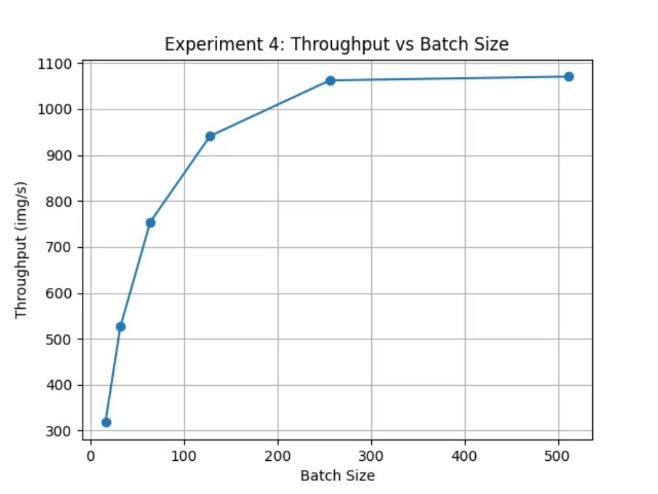
Notes:
This line plot visualizes the relationship between batch size and throughput from Experiment 4. You can see a clear upward trend: As we increased the batch size from 16 to 256, throughput improved dramatically—from around 318 img/s to over 1060 img/s. At batch size 512, we reached the maximum throughput of ~1070 images/sec, showing that the GPU was fully saturated. The curve flattens after 256, meaning further increases offer diminishing returns while memory usage grows significantly. The takeaway is that larger batch sizes use the GPU more efficiently, but beyond a certain point, you don’t get much more speed—and you risk hitting memory limits. So, for our hardware, batch size 256 is the sweet spot, offering near-peak throughput with significantly lower memory usage than 512. This kind of tuning helps strike the perfect balance between performance and resource use.

Slide 24
Summary of Key Training Optimizations
1
Progressive Optimization
2
Massive Throughput Gain
Training advanced from CPU, to GPU, then to AMP for max speed.
Image processing rate improved nearly 35×, enhancing efficiency.
3
Epoch Time Cut
4
Memory & Accuracy Balance
Training time shrank dramatically from 19s to 1.8s per epoch.
AMP maintained model accuracy while lowering memory demands.
Notes:
To wrap up: Throughout this project, we followed a structured path—starting from single-threaded CPU training and advancing through multithreaded pipelines, GPU acceleration, and finally automatic mixed precision with AMP. As a result: We achieved a 35x increase in training speed, going from around 180 images per second to nearly 7,000. AMP gave us all the speed and efficiency benefits, while still maintaining model accuracy. Using torch.profiler, we clearly identified where time and memory were being spent—whether in convolutions, optimizer steps, or data loading. And finally, in Experiment 4, we tuned batch sizes and discovered that batch size 256 gave us the best trade-off between throughput and memory. This systematic profiling helped us not just train faster, but train smarter. Let me know if you want to follow this with a Q&A or future work slide.

